Slide 1
Leadership

Slide 2
Points to Ponder!!!
What makes working with one person a successful endeavor?
AND
Working with another person an unsuccessful endeavor?

Slide 3
Influence!
the ability to have an effect on others

Slide 4
Although a leader may be in a high-ranking position and have abundant knowledge and success, what make someone a leader is his or her
ability to influence others.

Slide 5

What Is Leadership?
Leadership
The ability to influence a group toward the achievement of goals.
Management
Use of authority inherent in designated formal rank to obtain compliance from organizational members.

Slide 6
What is leadership, and what is the difference between leadership and management?
In a nutshell, the difference between leadership and management is:
Leadership is setting a new direction or vision for a group that they follow.
ex: a leader is the spearhead for that new direction
Management controls or directs people/resources in a group according to principles or values that have already been established.

Slide 7
Managers vs. Leaders
Major Differences (Vineet Nayer, HBR, 2013)
Counting value vs Creating value
Circles of power vs Circles of influence
Managing work vs Leading people
Dealing with complexity vs Dealing with uncertainty
Doing things right vs doing right things
Maintaining vs Developing

Slide 8
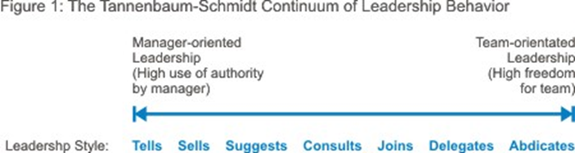

Slide 9
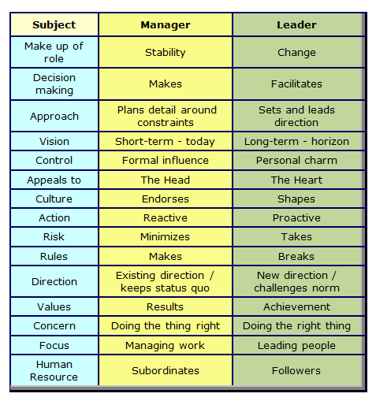

Slide 10
Leadership without management
...sets a direction or vision that others follow, without considering too much how the new direction is going to be achieved. Other people then have to work hard in the trail that is left behind, picking up the pieces and making it work.
Ex: At the council of Elrond, there is an argument about how they should proceed. Frodo Baggins rescues the council from the conflict by taking responsibility for destroying the ring. He sets a direction, but has no idea how to go about it. During the quest, most of the management of the group comes from others - particularly Gandalf and Aragorn.
Management without leadership
...controls resources to maintain the status quo or ensure things happen according to already-established plans.
Ex: a referee manages a sports game, but does not usually provide "leadership“ because there is no new change, no new direction - the referee is controlling resources to ensure that the laws of the game are followed and status quo is maintained.

Slide 11
LEADERSHIP
THEORIES
Trait
Theories
Leaders are Born
Behavioral
Theories
Ohio State Studies
Uni. Of Michigan State
Contingency
Theories
Fiedler Model
Hersey and Blanchard’s
Situational Theory
Path Goal Theory
New Theories
Leader Exchange Theory
Vroom & Yetton’s
Leader Participation Model

Slide 12
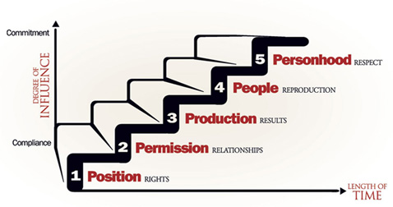
5 Levels of Leadership

Slide 13
The Five Levels of Leadership
A tool that demonstrates how influence works.
Every relationship in your organization fits into one of the five levels.
Picture them as a series of stairs, with the first step on the bottom.

Slide 14
1. Position
Level of Influence:
- The lowest level for any leader because it is based ONLY on a title or job description.
- People follow you only because they have to. You have little influence in their lives.

Slide 15
2. Permission
Level of Influence:
- This level is primarily based on the relationships you have with others.
- People follow you because they want to- they give you permission to lead.
- But… you must climb to the next level to reap the true rewards of influence.

Slide 16
3. Production
Level of Influence:
- Your influence is strengthened as a result of what you and your people accomplish together.
- People follow you because they have heard what you have done for your group or the organization.
- Although very rewarding, this level does not bring lasting success.

Slide 17
4. People Development
Level of Influence:
- You develop and inspire other leaders, not just inspire followers.
- People follow you because of what you’ve done for them personally.
- There’s almost nothing you can’t accomplish at this level.

Slide 18
5. Personhood
Level of Influence:
- Leaders who have spent a lifetime pouring their lives into others sometimes find themselves on this level.
- People follow them because of who they are and what they represent.

Slide 19
"It's not the position that makes the leader; it's the leader that makes the position. A leader influences people. Leadership is influence. It’s that simple.
Whether you’re influencing a little league baseball team, or a team of executives, your effectiveness has nothing to do with what your title or position is. Your effectiveness as a leader is defined by how well you influence others and how well you serve others. You need to bring out the best in yourself so you can bring out the best in others.”
~ John C. Maxwell

Slide 20


Slide 21
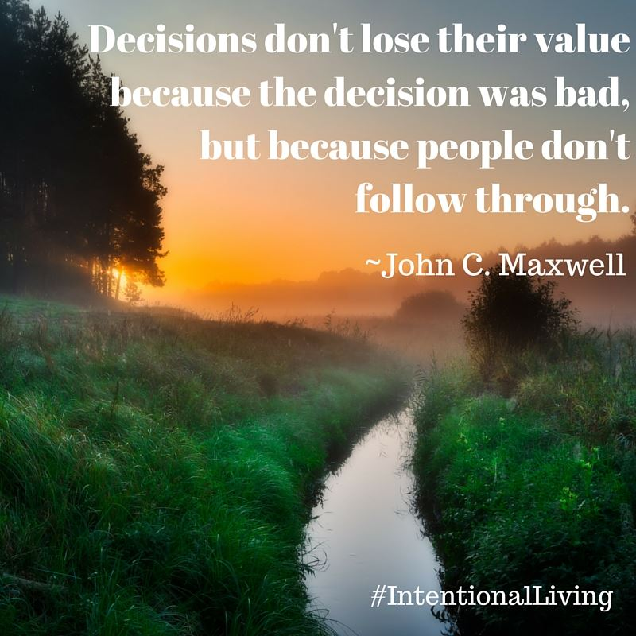

Slide 22
LEADERSHIP
THEORIES
Trait
Theories
Leaders are Born
Behavioral
Theories
Ohio State Studies
Uni. Of Michigan State
Contingency
Theories
Fiedler Model
Hersey and Blanchard’s
Situational Theory
Path Goal Theory
New Theories
Leader Exchange Theory
Vroom & Yetton’s
Leader Participation Model

Slide 23
Trait Theories
Leadership Traits:
Ambition and energy
The desire to lead
Honest and integrity
Self-confidence
Intelligence
High self-monitoring
Job-relevant knowledge
Traits Theories of Leadership
Theories that consider personality, social, physical, or intellectual traits to differentiate leaders from non-leaders.

Slide 24
Trait Theories
Limitations:
No universal traits found that predict leadership in all situations.
Traits predict behavior better in “weak” than “strong” situations.
Unclear evidence of the cause and effect of relationship of leadership and traits.
Better predictor of the appearance of leadership than distinguishing effective and ineffective leaders.

Slide 25
Behavioral Theories
Behavioral Theories of Leadership
Theories proposing that specific behaviors differentiate leaders from non-leaders.
Trait theory: Leaders are born, not made.
Behavioral theory: Leadership traits can be taught.

Slide 26
Ohio State Studies
Initiating Structure
The extent to which a leader is likely to define and structure his or her role and those of sub-ordinates in the search for goal attainment.
Consideration
The extent to which a leader is likely to have job relationships characterized by mutual trust, respect for subordinate’s ideas, and regard for their feelings.

Slide 27
Ohio State Studies
The first element was tagged Initiating Structure and deals with Task Behavior, focusing on production issues.
Example: measuring production output.
The second element, Consideration for Workers, focused on the human side of the business and was also called Relationship Behavior.
Example: orientation of new employees
In this way the Ohio State Studies brought together the seemingly juxtaposed Scientific Management and Human Relations Movement.
An important finding of the Ohio State studies was that these two dimensions are independent.
This means that consideration for workers and initiating structure exist simultaneously and in different amounts. A matrix was created that showed the various combinations and quantities of the elements.

Slide 28
Ohio State Studies
Consideration is more strongly related to the individual.
The followers of leaders who were high in consideration were more satisfied with their jobs and more motivated and also had more respects for their leaders.
Initiating structure was more strongly related to higher level of group and organization productivity and more positive performance evaluations.

Slide 29
Assumptions
Assumptions guide behavior
Assumptions can be changed

Slide 30
Organizational Universals
Purpose (s)
People
Power

Slide 31
The Grid
Concern for People
Concern for Production

Slide 32
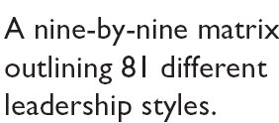
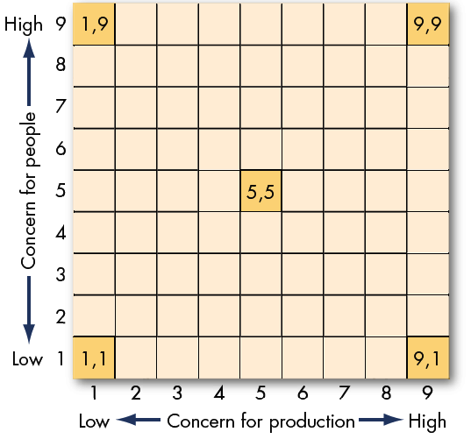
The Managerial Grid (Blake and Mouton)

Slide 33
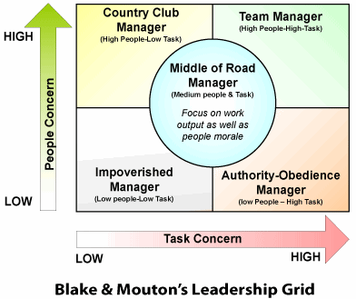

Slide 34
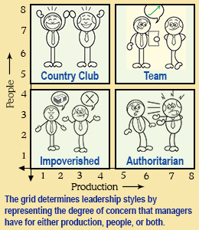

Slide 35
Factors that Determine Grid Style
Organization
Situation
Values
Personality
Chance

Slide 36
Dominant and Backup Style

Slide 37
University of Michigan Studies
Employee-Oriented Leader
Emphasizing interpersonal relations; taking a personal interest in the needs of employees and accepting individual differences among members.
Production-Oriented Leader
One who emphasizes technical or task aspects of the job.

Slide 38
University of Michigan Studies
A series of studies on leadership were done in Michigan University, starting in the 1950s. Under the general direction of Rensis Likert, the focus of the Michigan studies was to determine the principles and methods of leadership that led to productivity and job satisfaction. Two types of leadership behaviors were identified:
employee orientation (stress the human-relations aspect, employees are viewed as human beings with personal needs)
production orientation (stress on the technical and production aspects of the job, employees viewed as the means of getting the work done).

Slide 39
University of Michigan Studies
Leaders with an employee orientation showed genuine concern for interpersonal relations. Those with a production orientation focused on the task or technical aspects of the job.
The conclusion of the Michigan studies was that an employee orientation and general instead of close supervision yielded better results. Likert eventually developed four "systems" of management based on these studies; he advocated System 4 (the participative-group system, which was the most participatory set of leader behaviors) as resulting in the most positive outcomes.

Slide 40
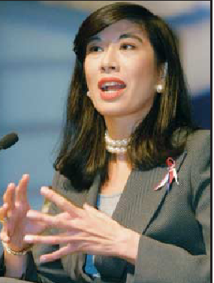
Scandinavian Studies
Development-Oriented Leader
One who values experimentation, seeking new ideas, and generating and implementing change.
Researchers in Finland and Sweden question whether there are only two dimensions (production-orientation and employee-orientation) that capture the essence of leadership behavior. Their premise is that in a changing world, effective leaders would exhibit development-oriented behavior.

Slide 41
Contingency Theories
The leader's ability to lead is contingent upon various situational factors, including the leader's preferred style, the capabilities and behaviors of followers and also various other situational factors.
Contingency theories contend that there is no one best way of leading and that a leadership style that is effective in some situations may not be successful in others.

Slide 42
Contingency Theories
An effect of this is that leaders who are very effective at one place and time may become unsuccessful either when transplanted to another situation or when the factors around them change.
This helps to explain how some leaders who seem for a while to have the 'Midas touch' suddenly appear to go off the boil and make very unsuccessful decisions.

Slide 43
Contingency Theories
Contingency theory is similar to situational theory in that there is an assumption of no simple one right way. The main difference is that situational theory tends to focus more on the behaviors that the leader should adopt, given situational factors (often about follower behavior), whereas contingency theory takes a broader view that includes contingent factors about leader capability and other variables within the situation.

Slide 44
Fiedler’s Contingency Model
Proposed by the Austrian psychologist Fred Edward Fiedler.
The contingency model emphasizes the importance of both the leader's personality and the situation in which that leader operates.
A leader is the individual who is given the task of directing and coordinating task-relevant activities, or the one who carries the responsibility for performing these functions when there is no appointed leader.
Fiedler relates the effectiveness of the leader to aspects of the group situation. Fred Fiedler's Contingency Model also predicts that the effectiveness of the leader will depend on both the characteristics of the leader and the favorableness of the situation.

Slide 45
Contingency Theories
Fiedler’s Contingency Model
The theory that effective groups depend on a proper match between a leader’s style of interacting with subordinates and the degree to which the situation gives control and influence to the leader.
Least Preferred Co-Worker (LPC) Questionnaire
An instrument that purports to measure whether a person is task- or relationship-oriented.

Slide 46
Fiedler’s Model: Defining the Situation
Leader-Member Relations
The degree of confidence, trust, and respect subordinates have in their leader.
Task Structure
The degree to which the job assignments are procedurized.
Position Power
Influence derived from one’s formal structural position in the organization; includes power to hire, fire, discipline, promote, and give salary increases.

Slide 47
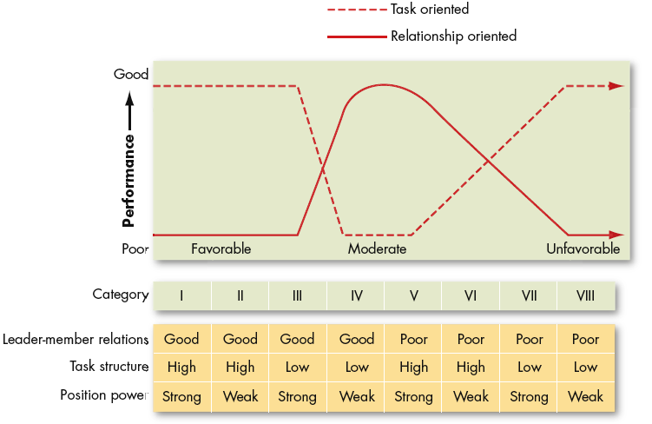
Findings from Fiedler Model

Slide 48
Cognitive Resource Theory
Cognitive Resource Theory
A theory of leadership that states that stress can unfavorably affect a situation and that intelligence and experience can lessen the influence of stress on the leader.
Research Support:
Less intelligent individuals perform better in leadership roles under high stress than do more intelligent individuals.
Less experienced people perform better in leadership roles under low stress than do more experienced people.

